Slide 1
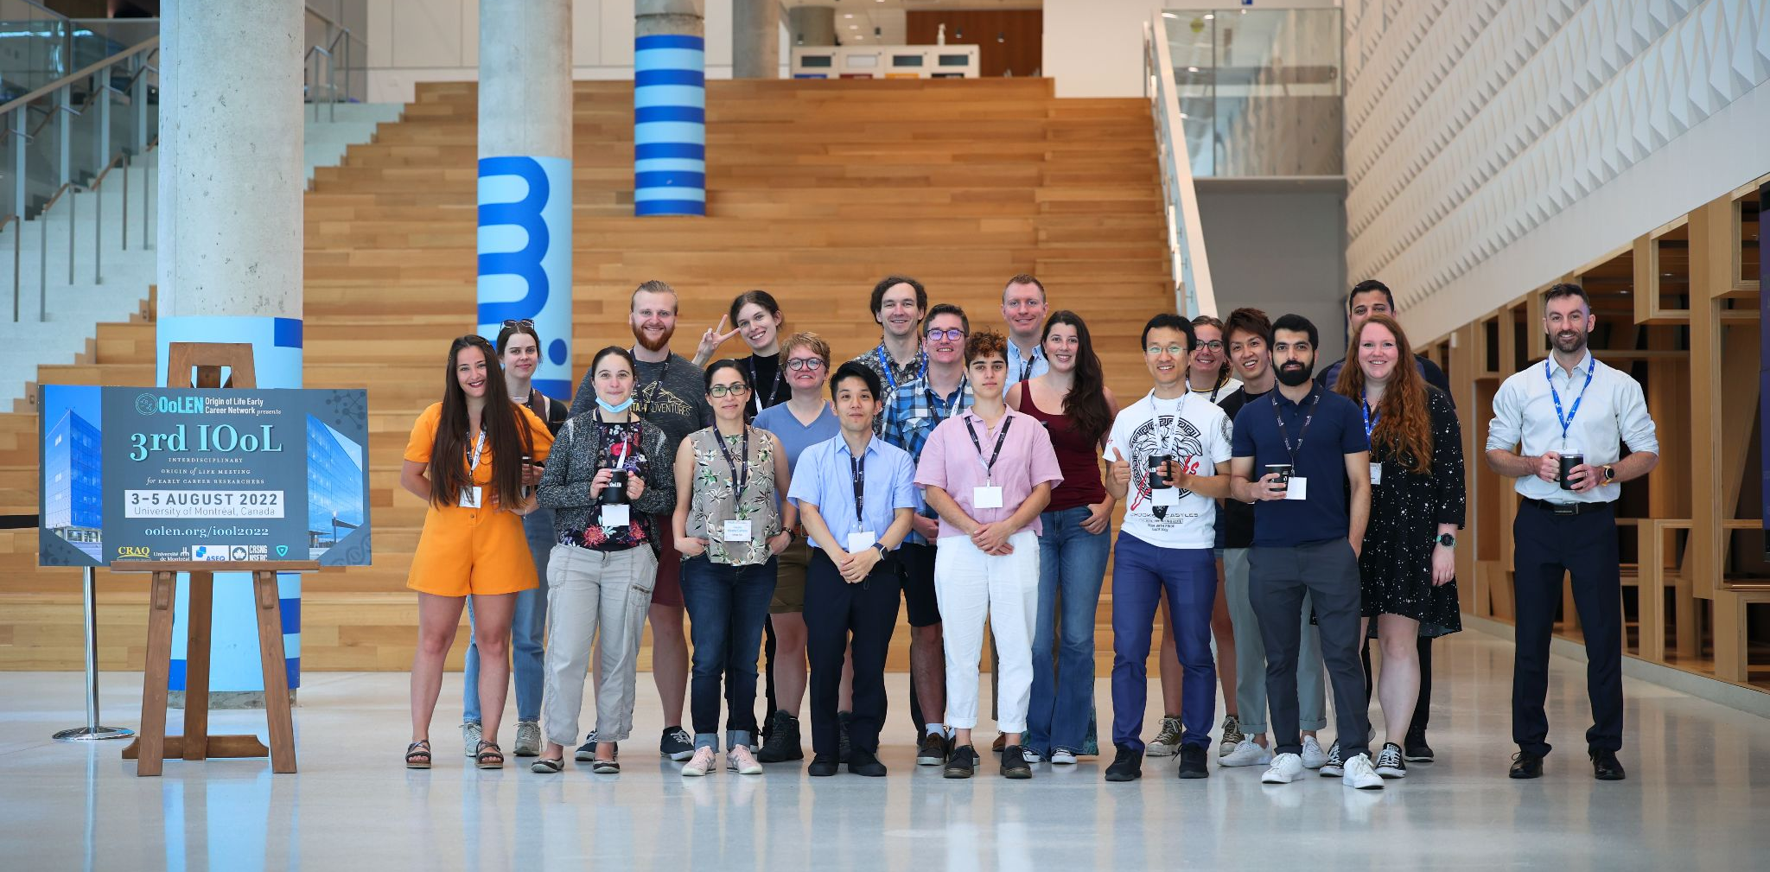
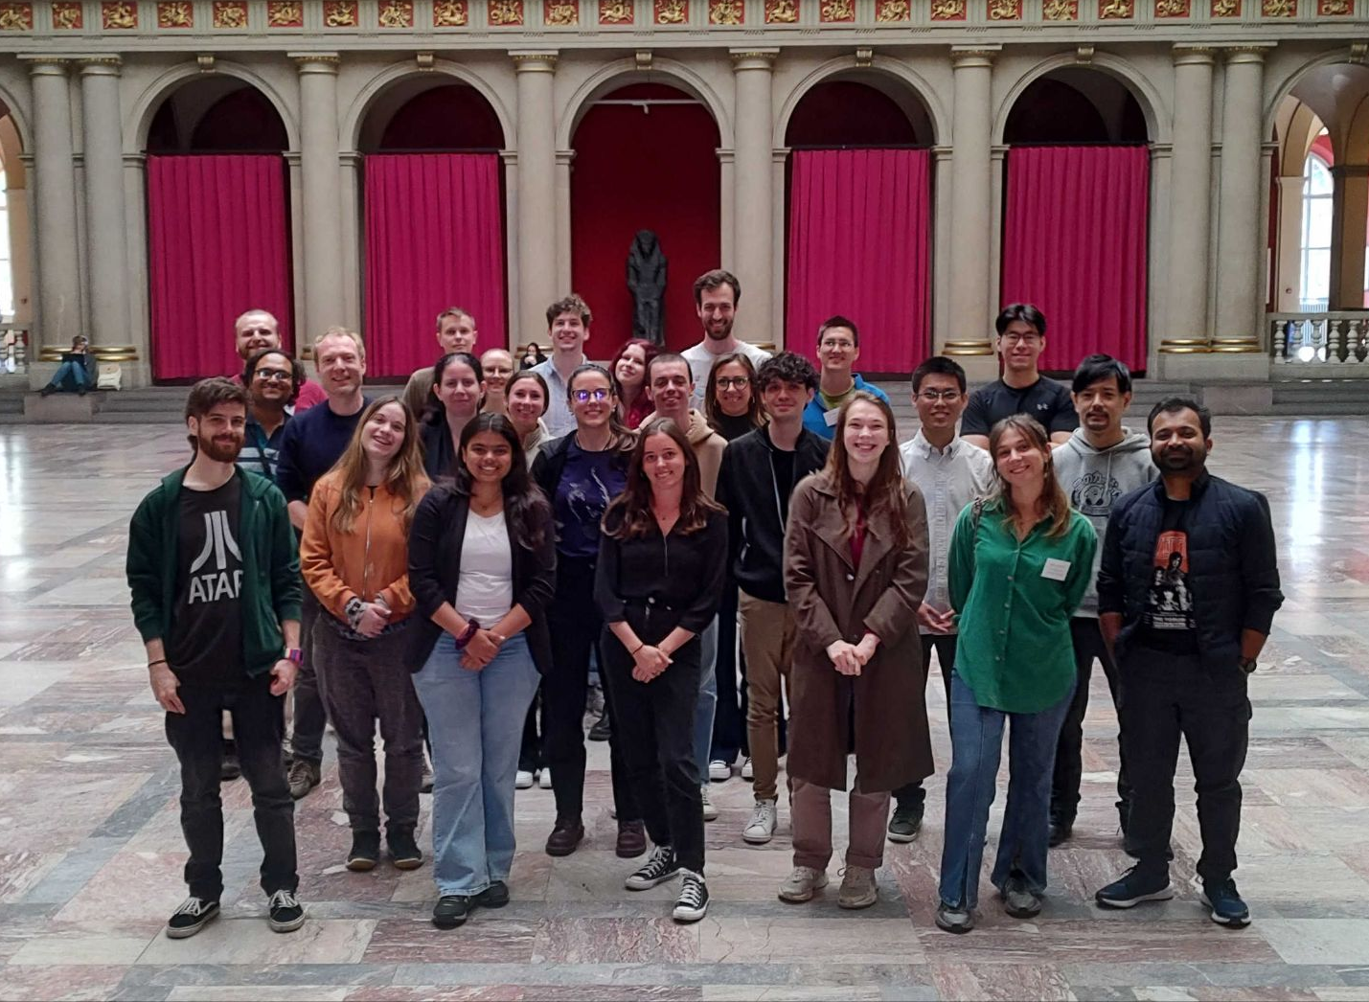
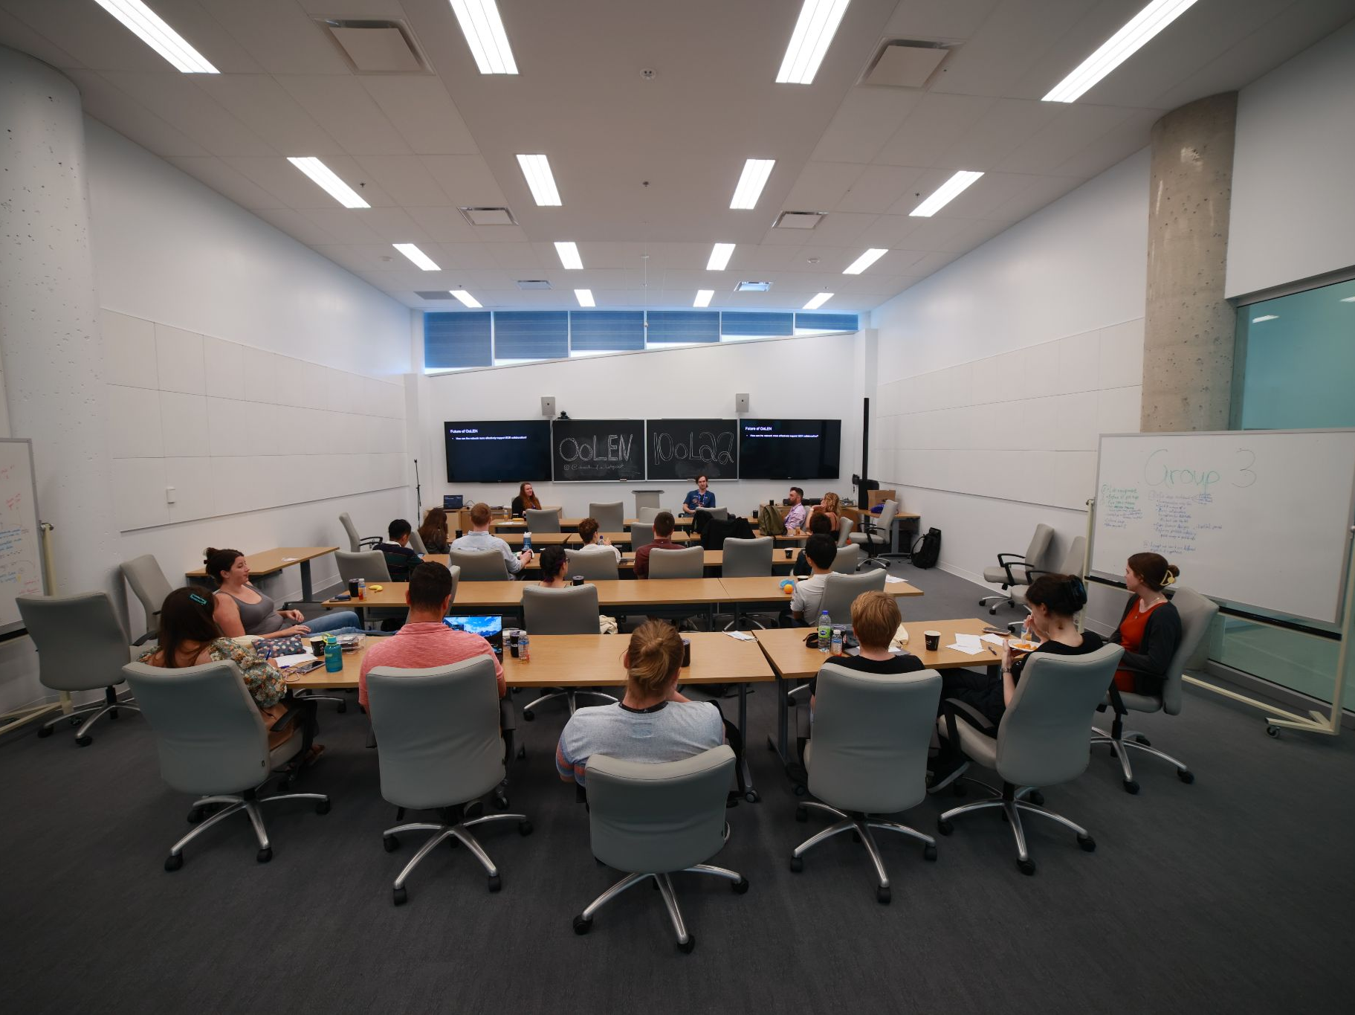
Join – Origins of Life Early-Career Network
.org
International
Relaxed environment without senior PIs
Openly discuss origins of life and interdisciplinary science
Biannual Conferences
A lot of fun! ☻
oolen.org/join-oolen/

